Slide 1

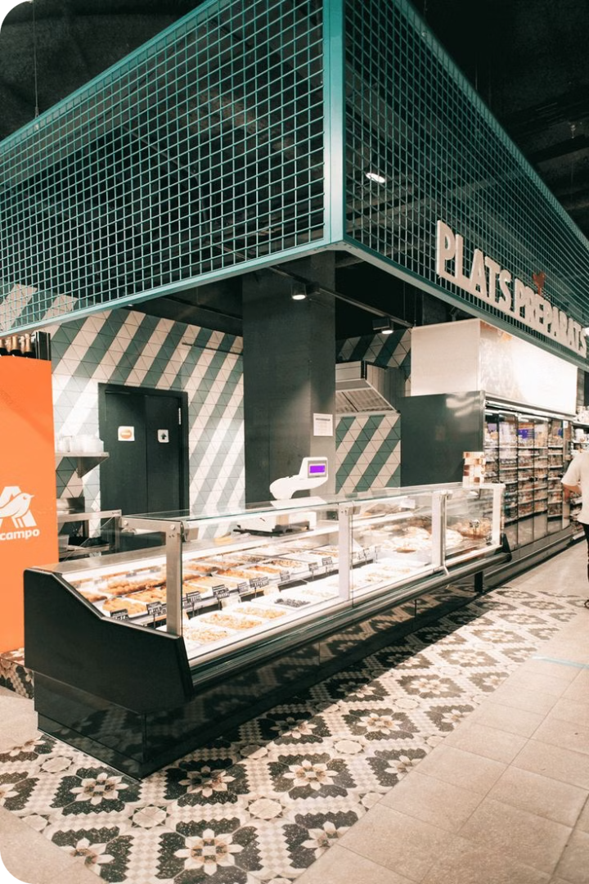
BOBO’S STORE: A Store System Management Project
This project focuses on building a store system management for BOBO’S STORE. A team of four members will develop the system, following a structured process.

Slide 2
Project Plan
1
Analysis & Requirement Gathering
The project begins with analyzing the store's needs and gathering requirements from stakeholders.
2
Design
The design phase involves creating diagrams and outlining the system's structure and functionality.
3
Implementation
The implementation phase involves building the system using VBA in Microsoft Excel.
4
Testing
The testing phase ensures the system meets the requirements and functions as expected.
5
Deployment
The deployment phase involves making the system accessible to users.
6
Maintenance
The maintenance phase involves ongoing support and updates to ensure the system remains operational.

Slide 3
Feasibility Study
Technical Feasibility
Financial Feasibility
Legal Feasibility
Operational & Scheduling Feasibility
The project is legally feasible as the system will enhance the store's competitiveness and improve stock management.
The project is technically feasible as the required resources are readily available, including VBA and UML STAR.
The project is financially feasible as the cost of development is outweighed by the financial benefits of the system.
The project is operationally and scheduling feasible as the team is competent and the project timeline is well-defined.

Slide 4
Client Requirements
1
Functional Requirements
2
Non-Functional Requirements
3
Usability Requirements
The system should manage stock, allow product insertion and removal, maintain user records, and generate reports.
The system should be reliable, efficient, usable, maintainable, and portable.
The system should be user-friendly and accessible to authorized personnel.
4
Performance Requirements
5
Security Requirements
The system should be fast, accurate, available, and have a low error rate.
The system should have user authentication and secure data access.

Slide 5
Stakeholder Roles
Stakeholder
Role
Project Team
Responsible for various aspects of the project, including analysis, design, implementation, testing, deployment, and maintenance.
Project Managers
Plan and manage the project, create and manage teams, and ensure timely completion.
Project Sponsors
Responsible for the overall success of the project, including appointing the project manager and team, defining success criteria, and ensuring successful delivery.
Customers
Define the requirements of the project.
End Users
Use the software to perform their tasks.

Slide 6


Software Development Lifecycle Model
Incremental Model
The incremental model is chosen for its flexibility, quick delivery of working software, and ease of testing and debugging.
Advantages
The incremental model allows for early customer feedback and reduces the risk of major changes later in the project.

Slide 7



Requirement Gathering Techniques
User Observation
Document Analysis
Brainstorming
Observing users interact with the existing system provides valuable insights into their needs and challenges.
Analyzing existing documents, such as store policies and procedures, helps understand the current processes and identify areas for improvement.
Brainstorming sessions with stakeholders generate a wide range of ideas and potential solutions.

Slide 8
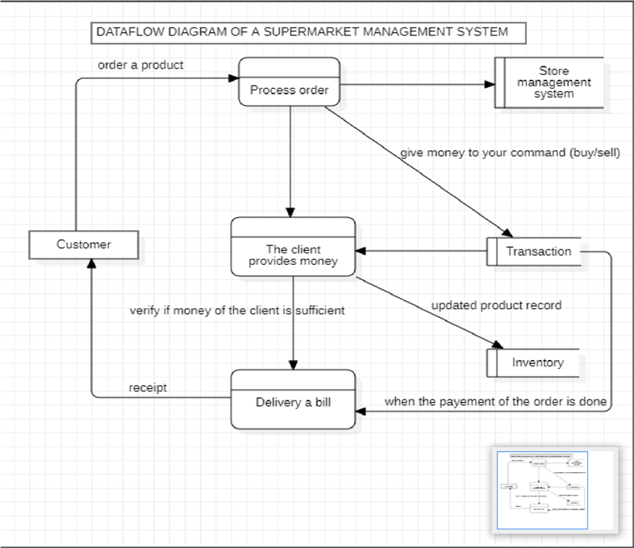
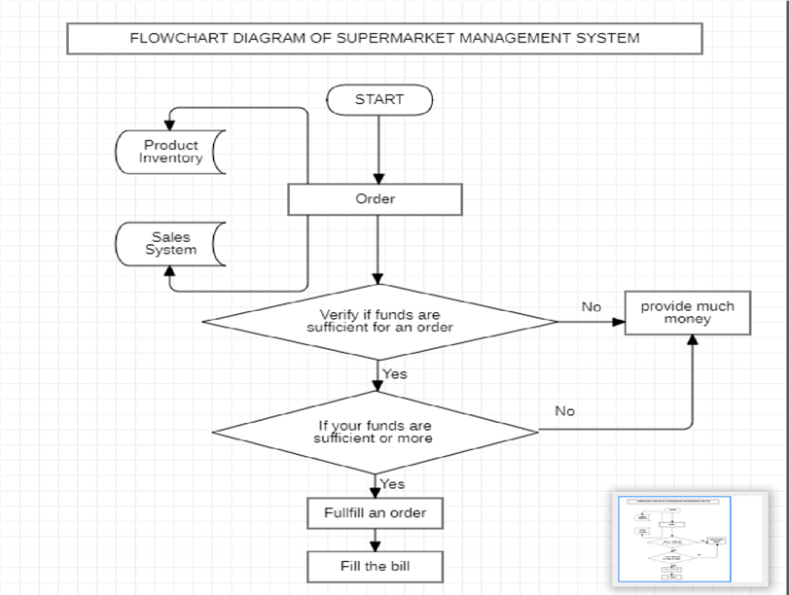
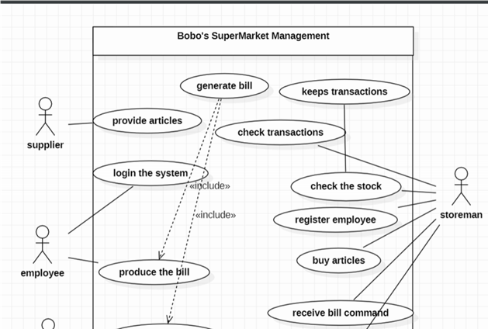
System Design
User Case Diagram
Flowchart Diagram
Data Flow Diagram
The user case diagram visually represents the interactions between users and the system.
The flowchart diagram graphically illustrates the sequence of steps involved in a specific process.
The data flow diagram shows the flow of data through the system.

Slide 9
System Implementation
Front-End Development
Back-End Development
The front-end development involves creating the user interface using VBA in Microsoft Excel.
The back-end development involves coding the system's logic and functionality using VBA in Microsoft Excel.

Slide 10
Problem and solutions
Problem Addressed
Solutions
Inventory Management: Maintaining the right balance of stock levels can be challenging
Tracking and Traceability: Efficiently tracking the movement of goods, from receiving to sales, can be complex, especially for businesses with multiple locations or a large product catalog.
Employee Management: Scheduling, tracking employee productivity, and managing staff training and performance can be complex, particularly for stores with high turnover or part-time workers.
Inventory Management:
Implement inventory tracking and forecasting software to help optimize stock levels.
Tracking and Traceability:
Utilize a comprehensive store management system that integrates inventory, sales, and supply chain data.
Employee Management:
Integrate employee management tools (e.g., scheduling, time tracking) into the store management system.

Slide 11
Recommendation for future studies
Automated Inventory Management:
Study the feasibility and effectiveness of implementing autonomous inventory replenishment systems, using technologies like IoT sensors and robotic process automation.
Evaluate the impact of automated inventory management on operational efficiency
Cybersecurity and Data Privacy:
Conduct research on the evolving cybersecurity threats and data privacy regulations impacting store management systems
User Experience and Adoption:
Investigate the factors that influence user acceptance and adoption of store management systems, including interface design, ease of use, and change management strategies.

Slide 12
CONCLUSION
In conclusion, our analysis shows how as software engineering we can build a store system management and all steps we should do in other to develop a good, feasibility and an efficient system.
.

